Slide 1

Optimizing Advertising Spend for Sales Growth
Insights from Predictive Modeling of Advertising Impact
By,
Aditya M
VVCE, Mysore

Slide 2
Introduction:
The dataset used in this analysis contains information about advertising expenditures across TV, Radio, and Newspaper, along with corresponding sales data.
Goal: To determine which advertising medium has the most significant impact on sales and to build a predictive model for future sales based on advertising spending.
Dataset Overview:
The dataset includes 4 columns:
TV: Advertising expenditure on TV (in thousands of dollars).
Radio: Advertising expenditure on Radio.
Newspaper: Advertising expenditure on Newspapers.
Sales: Number of units sold.
Initial data exploration was performed to understand the spread and summary statistics.

Slide 3
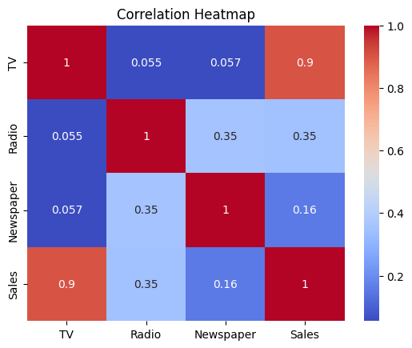
Correlation Analysis:
Correlation Heatmap:
The correlation between different advertising media and sales was analyzed.
TV showed the highest correlation with sales, indicating that TV advertising has the most significant impact on sales.
Correlation coefficients:
TV vs Sales: 0.78 (Highest correlation)
Radio vs Sales: 0.57
Newspaper vs Sales: 0.22 (Lowest correlation)

Slide 4
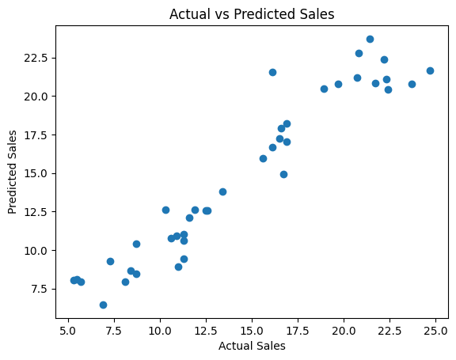
Linear Regression Model:
A linear regression model was built using all three variables: TV, Radio, and Newspaper.
The dataset was split into training and testing sets.
Model performance:
Mean Squared Error (MSE): 2.51
R^2 Score: 0.90
Visual Representation: Scatter plot comparing actual vs predicted sales, showing a good fit.

Slide 5
Sales Prediction Example:
Predicting sales for advertising expenditures of $200 on TV, $40 on Radio, and $50 on Newspaper:
Predicted Sales: 20.54 units.
Insights: Investing more in TV yields better sales performance.
Effect of Normalization:
The dataset was normalized using the StandardScaler to improve model performance.
Performance after normalization:
MSE: 2.49
R^2 Score: 0.91
Normalization slightly improved model performance.

Slide 6
Impact of Advertising Mediums:
A separate model was built using only Radio and Newspaper as predictors.
Model performance:
MSE (Radio & Newspaper only): 8.35
R^2 Score (Radio & Newspaper only): 0.67
Insight: TV remains the most impactful advertising medium for driving sales.
Key Insights and Recommendations:
Key Insights:
TV advertising has the highest impact on sales, followed by Radio and Newspaper.
A predictive model with all three advertising mediums yielded the best performance.
Normalizing the dataset improved the model slightly.
Recommendations:
Allocate more budget towards TV advertising to maximize sales.
Radio advertising can be used as a complementary medium.
Newspaper advertising has minimal impact and can be deprioritized.

Slide 7
Conclusion:
The analysis highlights the importance of effective budget allocation across different advertising mediums.
The linear regression model provides a reliable way to predict sales based on advertising spending.
Future steps: Exploring other machine learning models for better accuracy and consider more features like digital ads or market conditions.

